Slide 1
ADRUK Coding course: Introduction to SQL
Cameron Kelly Barbara Katz

Slide 2


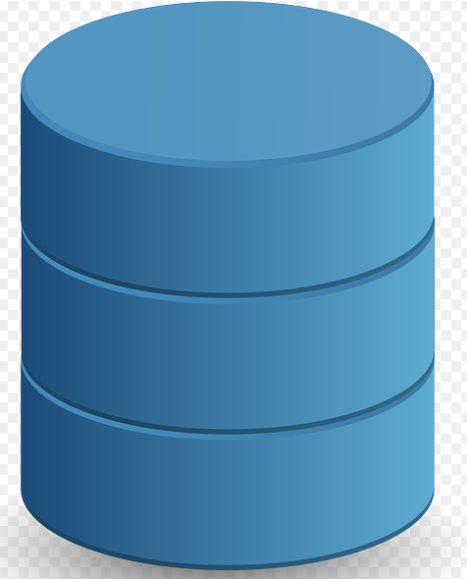



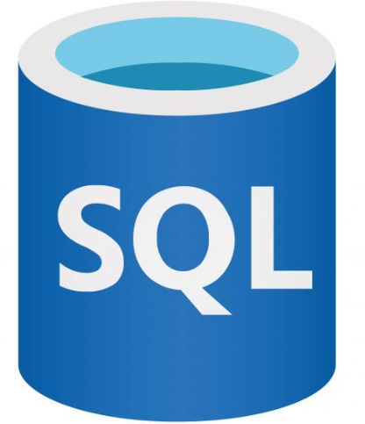
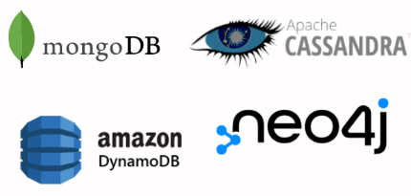
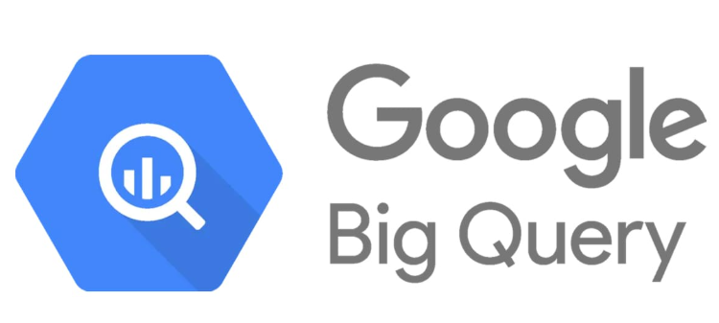

Why SQL?
Larger datasets
Much faster!
Database schema defines relationships between tables ➡️ data integrity!
Security and RBAC
RDBMS vs NoSQL
Datacise
SRS

Slide 3
Database Structure
SQL Server
Database 1
Database 2
Database N
Tables
Views
Security

Slide 4
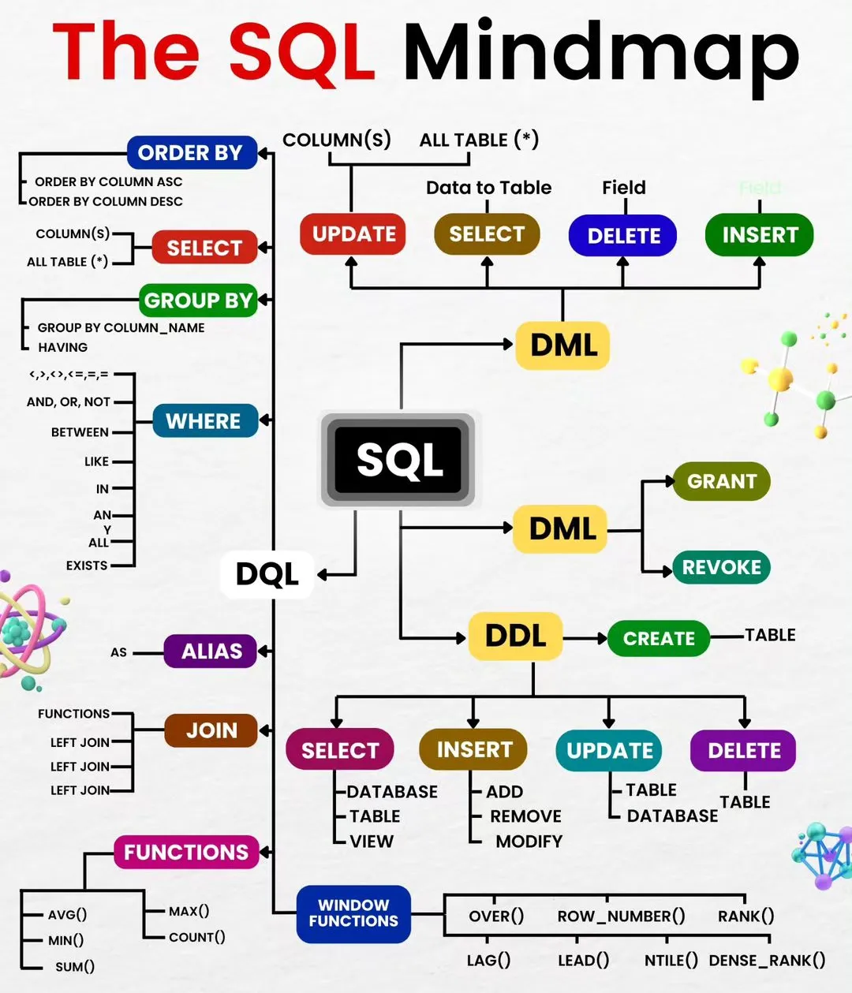




Let’s query!
Welcome to Datacise: basic SELECT queries
MIN, MAX
AVG
COUNT
SUM
WHERE
GROUP BY
LIMIT
Help when you need it

Slide 5
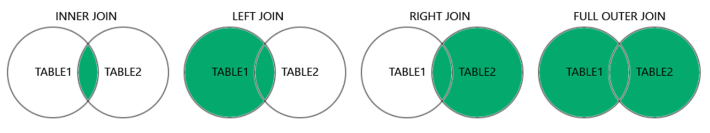

JOINS
Combine data from 2 different tables based on a common variable(s)
JOINs are by default are an INNER JOIN but can be expanded to include LEFT JOIN, RIGHT JOIN, FULL OUTER JOIN.

Slide 6
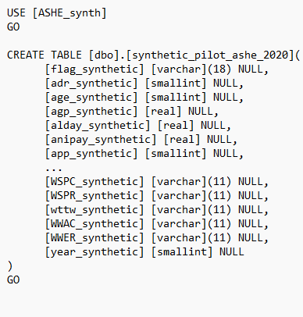
Defining your own tables: datatypes
SQL server datatypes
SQLite: text, numeric, int, real, blob
Correct data definition is crucial for query performance
Wrong type? No problem! Use CAST or CONVERT
Read more about database design: Primary keys, foreign keys and database normalisation

Slide 7
INDEXING
Indexing can add a level of pre-sorting to your query
Increase compression on a table
Create Keys based on multiple variables
Indexes
Function | Example Syntax | Description
INDEX | CREATE INDEX index1 ON dbo.table1 (column1,…,columnN); | Creates a Non-clustered index called “index1” on table1 based on column1,…,columnN (Add "CLUSTERED" or "UNIQUE" before INDEX to get different variants of Index

Slide 8

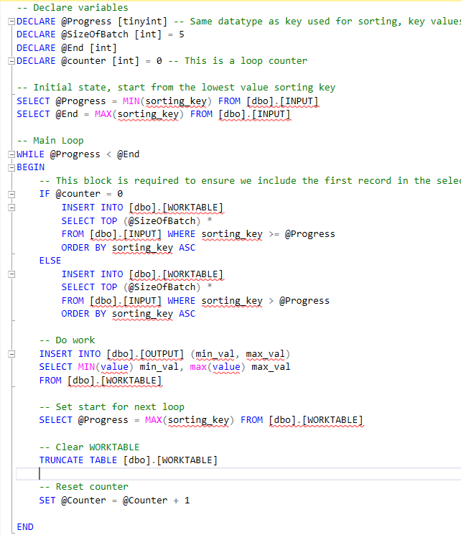
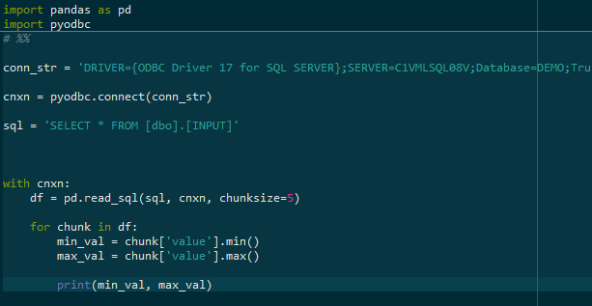
Working efficiently
Be mindful when working with large datasets
Run queries only on columns you really need
Load only the top records when you can (e.g. during testing) by using TOP (SQL server) or LIMIT (SQLite)
Clean and format the data to enhance performance
Use random samples where you can
Chunk process the data

Slide 9
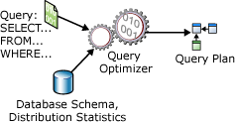
Query Execution
Query optimiser
Lots of factors taken into account under the hood.
Prepping an efficient query increases the speed.
Query Optimisation MS

Slide 10

Trusted Research Environments
Secure Research Service – ONS based.
Shared environment, running times can be long.
Linked data
Metadata catalogues
Changing variable names
Not all platforms use the same technology
Data provisioning methods

Slide 11

Safe Data
5 Safes Framework created by ONS, adopted by many TREs
You are "Safe People"
Accredited Researchers
Speak up if you think something is wrong.

Slide 12
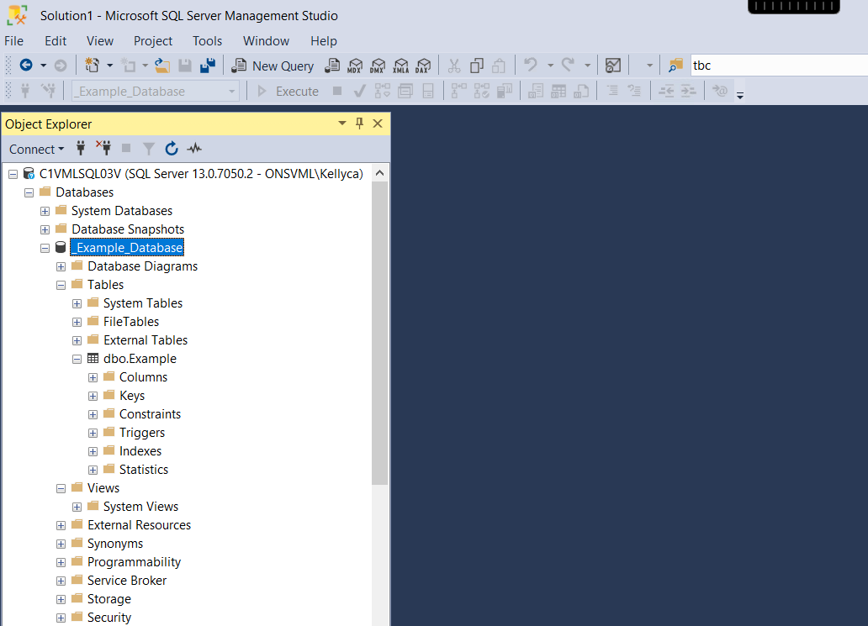
Explore SSMS within the SRS
Microsoft Based SQL
View Provision
Bespoke datasets

Slide 13

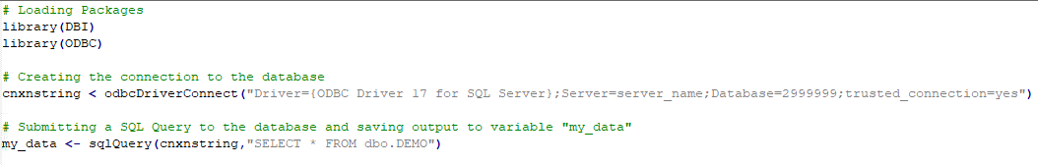

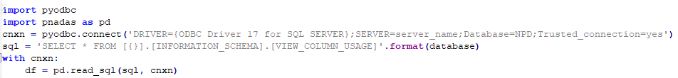

ODBC: Access your SQL environment using R, Python, Stata and more!
pandas

